Slide 1

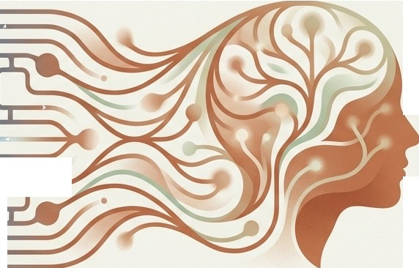
Beyond the Calculator: Architecting the General Mind
Understanding the cognitive leap from Narrow Al to Artificial General Intelligence.
,,,.
A
A guide to understanding how AGI thinks.
Isl\ NotebookLM

Slide 2

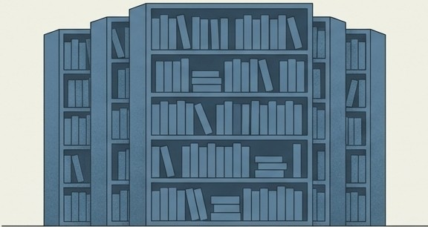

True Intelligence is Adaptability, Not Just Knowledge
•
•
I/
The Library (Storage)
Intelligence is notoriously difficult to define. A library contains all the facts, but it cannot use them.
The Detective (Processing)
True intelligence is the ability to accomplish goals in a wide range of environments. It is not just having data but connecting it.
Knowing facts is static. Processing information to solve unforeseen problems is intelligence.
I'S\ NotebookLM

Slide 3

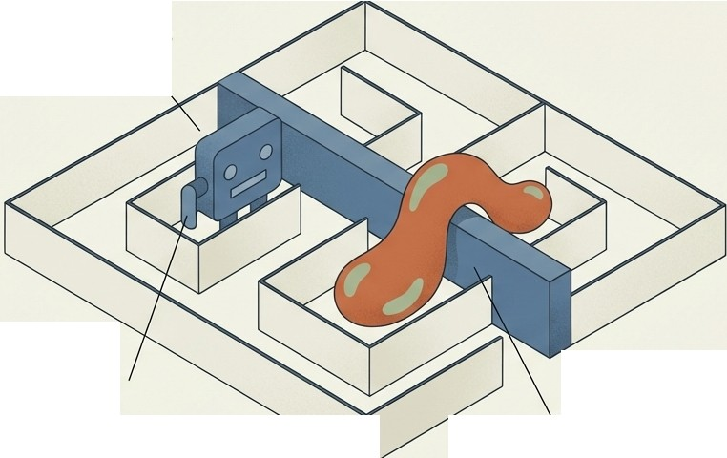
• •
T
eA apta I I
Criterion
A calculator is faster than a human, but it is not intelligent. It cannot pivot.
If the input format changes, it fails.
Calculator:
Fails when rules change.
A truly intelligent agent can formulate a sequence of actions to achieve a specific outcome even when the rules change.
Calculator: Fails when rules change.
Intelligent Agent: Pivots strategy.
Isl\ NotebookLM

Slide 4

Narrow AI: The Brilliant Specialist
Current technology, known as Narrow Al, is designed for specific tasks like recognizing faces or playing chess. It excels at pattern recognition within a fixed domain.
The Flaw: Brittleness
It is "brittle." If the rules of the task change slightly (e.g., the chess board changes size), the system fails. It requires massive, specific training data to function.
Isl\ NotebookLM

Slide 5

AGI: The Versatile Generalist
Artificial General Intelligence (Strong Al) possesses generalized cognitive abilities. It operates with Domain Independence.
The Mechanism: Transfer Learning
Through Transfer Learning , AGI can learn the logic of chess, apply that reasoning to learn cooking, and then pivot to diagnosing a disease. It possesses autonomy and creativity.
I'S\ Not eboo kL M

Slide 6





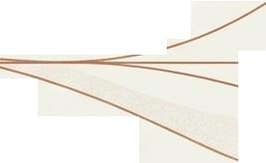
e Capa 1• 1•----
T
Gap
Specific / Single-domain
Brittle (Fails on rule changes) Requires massive data
Pattern Recognition & Prediction
General I Multi-domain
Adaptable (Navigates rule changes)
Zero-shot learning (Reasoning) General Reasoning &
Cross-domain competence

Slide 7
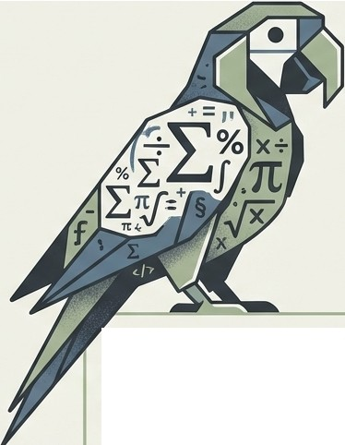
The ''Stochastic Parrot'' Problem
E=mc²
I a gree .
Current Large Language Models predict the next word based on statistics, not meaning. They mimic language rather than
reasoning about reality.
The Analogy: The model knows the word 'Apple' is statistically likely to appear near the word 'Red.' It does not, however, know what an apple is physically

Slide 8
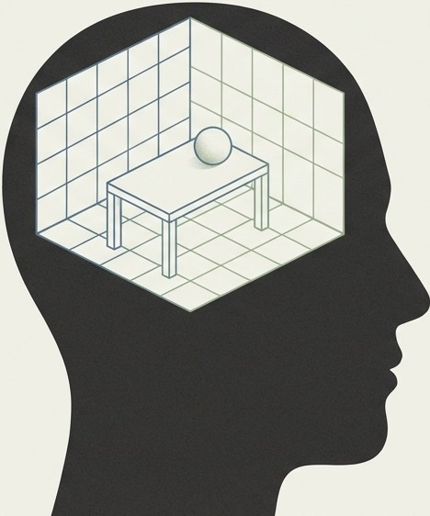
The Missing Component: World Models
To bridge the gap to AGI, a system needs an internal simulation of physics, causality, and human behavior.
Definition: A World Model is an engine that allows the Al to understand how the world actually functions, beyond just the text describing it.

Slide 9


Reasoning vs. Reading
Scenario: Dropping a glass on concrete.
Narrow Al predicts the glass breaks because it has read that sentence thousands of times in its training data.
•••
•
AGI predicts the glass breaks because it has a World Model of gravity, fragility, and hardness. It understands causality.
••
Gravity :
••
'Y• t--..
Concrete (Hardness > Glass)
Takeaway: Without this "Common Sense," Al makes basic errors when faced with new situations.
/I;\\ NotebookLM

Slide 10
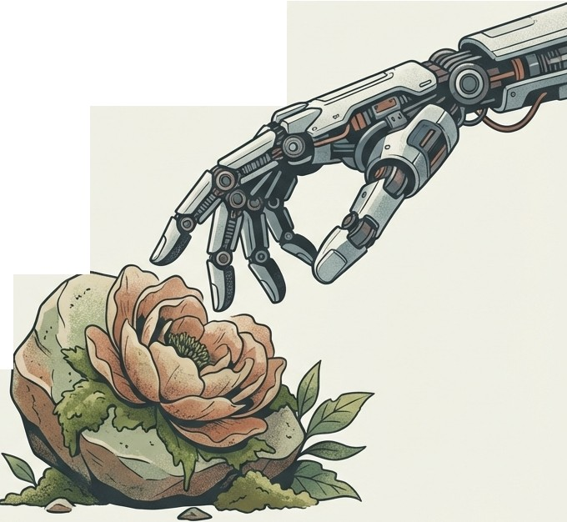
The Embodiment Hypothesis
Can an entity truly understand the concept of ''sticky'' if it has never touched honey? Can it understand ''heavy'' without muscles?
The Argument: Proponents argue that true World Knowledge requires physical experience­ existence in the world, not just just observing it.

Slide 11

The Oracle Counterpoint
The Argument: Opposing views argue
that intelligence is strictly information processing. AGI could exist entirely as software on a server.
•
r •
• •
•
•
The Role: It acts as an
The Role: It acts as an "Oracle"- solving complex problems without physically building the solutions.
•
0
•
•
•
•

Slide 12

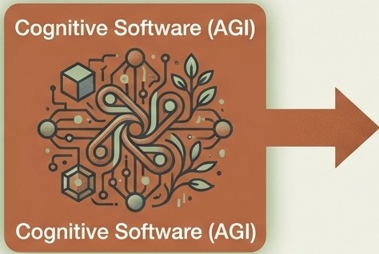





The Distinction Between Mind and Vessel
Sensors / Body
Action / Thought
While robotics and sensors are helpful enhancers for grounding abstract concepts hrough feedback', they are not the intelligence itself.
Conclusion: Robots are the vessel.
G is11ie n .
mboat d
is simply the
combination of general intelligence with a physical form.

Slide 13

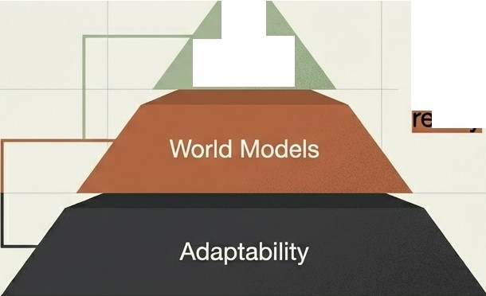

The chitecture of a General Mind
r---------,
: Robotics :
1 (Optional Add-on) 1
L---------J
AGI
Outcome
Moving from mimicking patterns to
a .

Slide 14






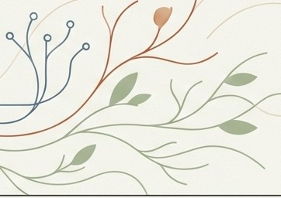






•
•
I 1cr
eason
AGI represents the technological replication of the human capacity to learn and reason across domain.s
Closing Statemen:t
The leap isn't about processing data faster. It is about grounding that data in an understanding of the real world- physica,lsocia,l and abstract.

